Slide 1

Course : ENTR6003 – Entrepreneurship 1
Year : September 2017
Effective Presentation
& Negotiation Skill (L)
Session 6
F2F

Slide 2
LO 1 : Identify the innovative business idea
Learning Objectives
LO 2 : Describe the value proposition of the created business idea

Slide 3
Sub Topics
Effective Presentation
Presentation Design
Negotiation Skill

Slide 4
Effective Presentation

Slide 5

What is Presentation?
A presentation is a means of communication that can be adapted to various speaking situations, such as talking to a group, addressing a meeting or briefing a team.
A presentation can also be used as a broad term that encompasses other ‘speaking engagements’ such as making a speech at a wedding, or getting a point across in a video conference.
(https://www.skillsyouneed.com/present/what-is-a-presentation.html)

Slide 6
Effective Presentation:
Preparation
Build a story.
Presentations are boring when they present scads of information without any context or meaning. Tell a story, with the audience as the main characters.
Keep it relevant.
Audiences only pay attention to stories and ideas that are immediately relevant.
Consider what decision you want them to make, then build an appropriate case.
Cut your intro. A verbose introduction that describes you, your firm, your topic, how you got there, only bores people. Keep your intro down to a sentence or two, even for a long presentation.
Begin with an eye-opener.
Kick off your talk by revealing a shocking fact, a surprising insight, or a unique perspective that naturally leads into your message and the decision you want made.
Keep it short and sweet.
When was the last time you heard someone complain that a presentation was too short? Make it half as long as you originally thought it should be (or even shorter).

Slide 7
Effective Presentation:
Preparation
Use facts, not generalities.
Fuzzy concepts reflect fuzzy thinking. Buttress your argument, story and message with facts that are quantifiable, verifiable, memorable and dramatic.
Customize for every audience.
One-size-fits-all presentations are like one-size-fits-all clothes; they never fit right and usually make you look bad. Every audience is different; your presentation should be too.
Simplify your graphics.
People shut off their brains when confronted with complicated drawings and tables. Use very simple graphics and highlight the data points that are important.
Keep backgrounds in the background.
Fancy slide backgrounds only make it more difficult for the audience to focus on what's important. Use a simple, single color, neutral color background.
Use readable fonts.
Don't try to give your audience to get an eyestrain headache by using tiny fonts. Use large fonts in simple faces (like Arial); avoid boldface, italics and ALL-CAPS.
Don't get too fancy.
You want your audience to remember your message, not how many special effects and visual gimcracks you used. In almost all cases, the simpler the better.

Slide 8
Effective Presentation:
Presentation
Check your equipment ... in advance.
If you must use PowerPoint, or plan on showing videos or something, check to make sure that the setup really works. Then check it again. Then one more time.
Speak to the audience.
Great public speakers keep their focus on the audience, not their slides or their notes. Focusing on the audience encourages them to focus on your and your message.
Never read from slides.
Guess what? Your audience can read. If you're reading from your slides, you're not just being boring–you're also insulting the intelligence of everyone in the room.
Don't skip around.
Nothing makes you look more disorganized than skipping over slides, backtracking to previous slides, or showing slides that don't really belong. If there are slides that don't fit, cut them out of the presentation in advance.
Leave humor to the professionals.
Unless you're really good at telling jokes, don't try to be a comedian. Remember: When it comes to business presentations, polite laughter is the kiss of death.

Slide 9
Effective Presentation:
Presentation
Avoid obvious wormholes.
Every audience has hot buttons that command immediate attention and cause every other discussion to grind to a halt. Learn what they are and avoid them.
Skip the jargon.
Business buzzwords make you sound like you're either pompous, crazy, or (worst case) speaking in tongues. Cut them out–both from your slides and from your vocabulary.
Make it timely.
Schedule presentations for a time when the audience can give you proper attention. Avoid end of day, just before lunch, and the day before a holiday.
Prepare some questions.
If you're going to have a Q&A at the end of your presentation, be prepared to get the ball rolling by having up a question or two up your sleeve.
Have a separate handout.
If there's data that you want the audience to have, put it into a separate document for distribution after your talk. Don't use your slide deck as a data repository.

Slide 10
Presentation Design

Slide 11
Designing a Presentation
Skip the Stock Template
Using the slide themes included in your software is presentation death. They’re overused, boring and usually pretty ugly. Create cleaner presentations by starting with a clean presentation and building from there.
Don’t Use More than 6 Lines of Text
Packing too much information into a slide will completely undermine its purpose. Remember: The audience often has to process everything you say while they view the slide.
Ditch the Bullet Points
Too many presentations are bullet point crazy. No one will remember 10 bullet points, but they will remember 10 compelling slides. Use each slide to build your case and incrementally tell your story. (Consider your slides to be an outline for what you’re saying.) Try to share one idea per slide.

Slide 12
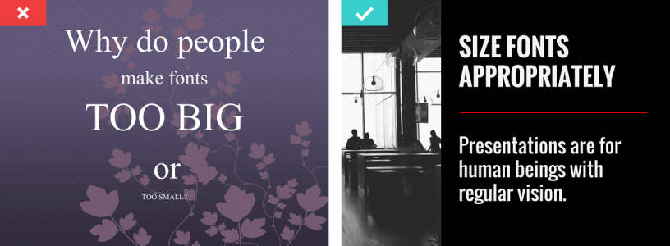
Designing a Presentation
Use Sans Serif Fonts
With typography, go for legibility over fun. While you can use a creative font for a slide title, avoid using it for body text. Instead, stick to clean, traditional typefaces like Helvetica. And if you’re using a dark background, make the text bold for readability.
Size Fonts Appropriately
Chances are you’re designing your presentation on a laptop—and that’s a much different size than the final presentation screen. When sizing your fonts, keep in mind that the text should be large enough to be read by the person in the back of the room.

Slide 13
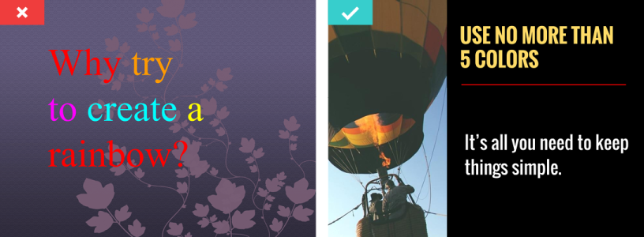
Designing a Presentation
Maintain a Strong Contrast Between Text and Background
In order for your message to pop, you need a high level of contrast between your text and the background. If your background image features a lot of variation, portions of your text may not be legible. In that case, a stylish bar of color behind the image can bring the legibility back while adding visual interest.
Use No More than 5 Colors
A harmonious palette can easily enhance the look of your entire presentation. No need for complex gradients or textures here; you can get excellent results with just the right colors. Use a tool like Adobe’s Kuler or a site like COLOURLovers to choose a good selection.

Slide 14
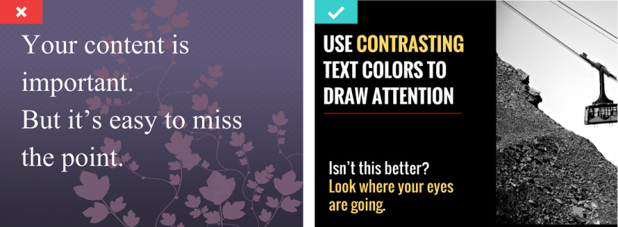
Designing a Presentation
Use Contrasting Text Colors to Draw Attention
It’s like bold and italic, but better. Use a single color in your selected palette to emphasize important points in your text. However, make sure not to overdo it.
Use Single Images
Images help make your presentation more visual, but don’t get carried away with too many on one slide. It’s a presentation, not a photo album. Limit your designs to a single image with simple or no text.

Slide 15

Designing a Presentation
Use Visuals to Increase Emotional Appeal
Visuals are there to help support your message; they can enhance comprehension, retention and elicit an emotional response that increases impact. Use powerful visuals to get your point across.
Freeze the Transitions
Finally, there are plenty of clever transitions built into today’s presentation software, but most quality presentations eschew any distracting transitions.

Slide 16
Negotiation Skill

Slide 17
Why Negotiation Skill
is important?
Why does negotiation matter?
Quite simply, the world would be a much angrier and more dissatisfied place without it, and we'd achieve very little in life due to constant conflict and misunderstanding.
A good negotiator finds a mutually acceptable way forward, instead of being at loggerheads with people who hold different views or who are working toward different goals. He or she will skillfully close a deal, agree a new training plan, set a schedule, or fine-tune processes. Good negotiation leads to better working practices, and increased satisfaction in the workplace and in life in general.

Slide 18
What is Negotiation?
“You have negotiated successfully when you navigate through, or prevent, conflict, achieve an acceptable solution to a mutual problem, and agree follow-up actions that both sides are willing to implement. Ideally, you will achieve your own goals as a result, but often you will have to compromise.”
An important point to remember is that negotiation isn't limited to "big decisions." Whether you're discussing a potential pay raise for a team member, saying "no" to a task from a co-worker, or even choosing a Friday-night takeout with the family, you can use negotiation skills several times a day, for challenges large and small.

Slide 19
Negotiation:
Preparation
Things that should be prepared are:
Goals – what are you trying to achieve during the negotiation? And what do you think the other person's goals are?
Trades – what might you be able to give away or ask for? What can the other party offer you?
Alternatives – if you really can't achieve your goals, what would be your best alternative to a negotiated agreement (BATNA)? Your position will be more secure if you have a number of options, so it's worth putting a lot of time into this.
Relationships – how have negotiations with the other party worked out in the past? What kind of relationship do you want with him in the future?
Expected outcomes – what precedents have been set? Based on those and on your current knowledge, what seems to be the most likely outcome?
Consequences – is this a big, one-off deal or one of many small negotiations? What do you and the other party stand to gain or lose?
Power – who holds the power? How will this affect the negotiation?
Solutions – what do you now consider to be a fair outcome?

Slide 20
Negotiation:
Negotiate!
TIPS in the NEGOTIATION PROCESS
Treat the other person with respect.
Separate the person from the problem.
Understand her point of view.
Listen first, talk second.
Stick to the facts.
Explore options together.

Slide 21
Negotiation:
Negotiate!
When you're negotiating with someone who you'll likely continue to deal with and whose opinion of you matters, you'll both want to be open and fair. Try to achieve a win-win result by being as creative as you can about all aspects of the issue being discussed.
For example, you could:
"Expand the pie" – change what's on offer to accommodate both parties.
Suggest alternative solutions – offer something in place of what's being asked for.
Trade favors – agree between you which priorities to honor for one another.
Offer compensation – recognize a demand that's been given up.
Make it easy for the other party to act in the way that you'd like – remove practical barriers or subsidize the cost.

Slide 22
References
https://www.inc.com/geoffrey-james/how-to-fix-your-presentations-21-tips.html
https://visage.co/11-design-tips-beautiful-presentations/
https://www.mindtools.com/pages/article/essential-negotiation.htm

